Slide 1
Excitation and Contraction of Smooth Muscle
Smooth Muscle, which is compose of smaller fibers than skeletal muscles, usually 1 - 5 µm in diameter and only 20 - 500 µm in length.
In contrast, skeletal muscle fibers are as much as 30 times greater in diameter and hundreds of times as long.
Some principles of contraction are similar in both smooth muscle as to skeletal muscle; like attractive forces between myosin and actin, but the internal physical arrangement of smooth muscle fibers is different.

Slide 2
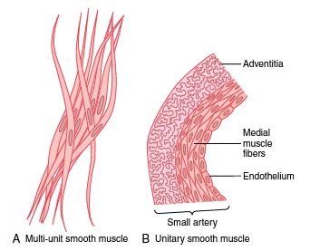
smooth muscle can be divided into two major types:
1- multi-unit smooth muscle.
2- unitary (or single-unit ) smooth muscle.

Slide 3
multi-Unit Smooth Muscle.
separate smooth muscle fibers. Each fiber is innervated by a single nerve ending, as occurs for skeletal muscle fibers.
Some examples of multi-unit smooth muscle are the ciliary muscle of the eye, and the piloerector muscles

Slide 4
Unitary Smooth Muscle.
Also called visceral smooth muscle.
Its a mass of thousands of smooth muscle fibers that contract together as a single unit. The fibers usually are arranged in sheets or bundles. cell membranes are adherent to one another at multiple points (by gap junctions) so that force generated in one muscle fiber can be transmitted to the next.
It is found in the walls of most viscera of the body, including the gastrointestinal tract, bile ducts, ureters, uterus, and many blood vessels.

Slide 5
Contractile Mechanism in Smooth Muscle
Smooth muscle contains both actin and myosin filaments.
Contractile process is activated by Ca, and ATP.
There are differences between smooth/ skeletal muscles, in:
1- excitation-contraction coupling,
2-way of control of the contractile process by Ca,
3-duration of contraction,
4- amount of energy required for contraction.
5- have not troponin complex like in ske.muscles >>> so contraction process is dif.

Slide 6
Physical Basis for Smooth Muscle Contraction
have not striated arrangement of actin /myosin as is found in skeletal muscle.
Instead, large numbers of actin filaments attached to dense bodies. These bodies are attached to the cell membrane or dispersed inside the cell. .
so, large numbers of actin filaments radiating from two dense bodies; the ends of these filaments overlap a myosin filament located midway between the dense bodies.

Slide 7
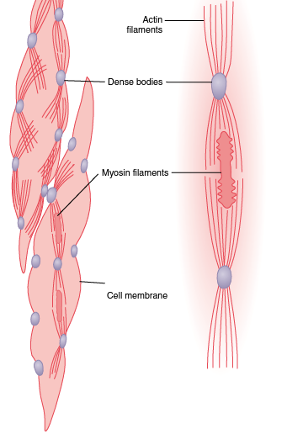

Slide 8
dense bodies serve the same role as the Z discs in skeletal muscle.
Sidepolar of myosin cross-bridges; This allows the myosin to pull an actin filament in one direction on one side while pulling another actin filament in the opposite direction.

Slide 9
Main differences between skeletal muscles and smooth muscles

Slide 10
1- Smooth muscle / Skeletal muscle contraction
skeletal muscles contract and relax rapidly.
while, smooth muscle contraction is prolonged tonic contraction, sometimes lasting hours or even days.

Slide 11
2- Nervous and Hormonal Control of Smooth Muscle Contraction
skeletal muscle fibers are stimulated by the nervous system
While, smooth muscle can be stimulated by:
nervous signals, hormonal stimulation, stretch of the muscle, and in several other ways.
.

Slide 12
Smooth muscle contains many types of receptor ( adrenergic, cholinergic ) that can stimulate / inhibit the contractile process, while skeletal muscle just have only one type (nicotinic).

Slide 13
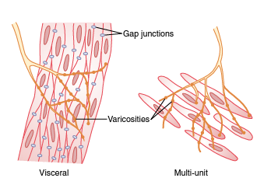
Innervations of Smooth Muscle
Autonomic nerve fibers innervate smooth muscle generally branch diffusely on top of a sheet of muscle fibers not make a direct contact with
muscle, instead
diffuse junction;
Secret its neurotras-
mitters in the Matrix
around smooth muscle.

Slide 14
Innervations of smooth muscle
Nerve fibers innervate the outer layer. Muscle excitation travels from outer layer to the inner layers by AP conduction by additional diffusion of the transmitter substance.
most of the fine terminal axons have multiple varicosities, vesicles contain transmitter substance.
Vesicles of skeletal muscle junctions, contain acetylcholine, While here the autonomic nerve fiber endings contain acetylcholine in some fibers and norepinephrine in another, (both are excitatory or inhibitory depends on receptors ).

Slide 15
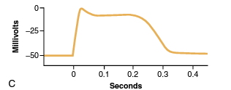
Action Potentials with Plateaus
The smooth muscle cell membrane has far more voltage-gated Ca-channels and few voltage-gated Na channels. Therefore, Na participates little in the generation of the AP in smooth muscle. Instead, flow of Ca++ to the interior is mainly responsible for the AP. Also, Ca-channels open more slowly than Na-channels, and remain open much longer >>> prolonged plateau.
Also, Inflow of these Ca act directly on the smooth muscle contractile mechanism to cause contraction.
Plateau: The onset of this AP is similar to that of the typical potential. However, the repolarization is delayed for several hundred to 1 second.

Slide 16
Regulation of Contraction by Calcium Ions
Like skeletal muscle, the initiating stimulus for smooth muscle contraction is an increase in intracellular calcium ions.
Increasing of Ca could mainly by:
nerve stimulation, hormonal stimulation, stretch of the fiber ….etc.

Slide 17
Ca-Calmedulin – Myosin Kinase
Smooth muscle cells contain a large amount calmodulin similar to troponin:
Intracellular Ca ++ conc. increases; through Ca-VGC in the cell membrane or the sarcoplasmic reticulum (SR).
Ca ++ binds to calmodulin ; Ca ++ -- calmodulin complex
Complex, then activates myosin light chain kinase (MLCK).
The MLCK phosphorylates the myosin light chain (MLC) leading to contraction of the smooth muscle.
When Ca ++ conc. decreases, due to pumping of Ca ++ out of the cell, the process is reversed and myosin phosphatase removes the phosphate from MLC, leading to relaxation Leads for :
attachment-detachment cycling of the myosin head with the actin filament.

Slide 18
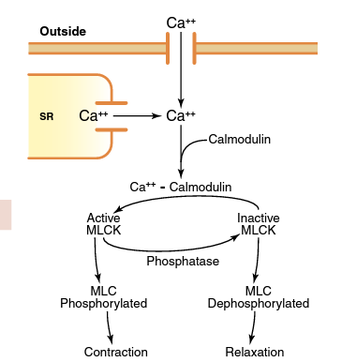

Slide 19
Stress-Relaxation of Smooth Muscle.
An important characteristic of smooth muscle, especially in visceral hollow organs; allow a hollow organ to maintain about the same amount of pressure inside its lumen despite long-term, large changes in volume.
For example, a sudden increase in fluid volume in the urinary bladder >>> stretching the smooth muscle in the bladder wall >>> increase in pressure in the bladder. SO by stress – relaxation of smooth muscles after 15 sec to 1 min, the pressure returns back to the original level.

